Slide 1

Structuring Conversations and Meetings
Using Result-Based Agendas
Notes:
Today we’re focusing on a practical tool to make meetings more purposeful and productive: the Results-Based Agenda.
This tool is aligned with Results Count and supports adaptive leadership by helping us clarify what we want to accomplish and structure how we get there.
We’ll look at how to design agendas that support better outcomes, stronger engagement, and clearer next steps.

Slide 2



Meeting Results
By the end of the meeting, participants will:
Understand the Building Blocks of Results-Based Agendas
Learn about and practice skills of effective questions and appreciative listening
Make Action Commitment to Practice Results-Based Agendas in the next two weeks
Notes:
We use results-based agendas at the County regularly, and here are the results we’re hoping to get:

Slide 3
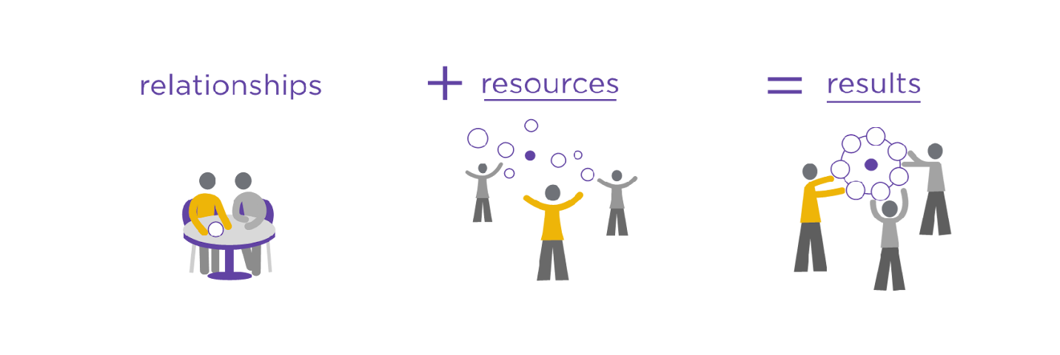
Composition Analysis and 3R Agenda
Notes:
This template uses the 3Rs: Relationships, Resources, and Results. Who’s connected to each of these? Who’s holding key relationships? Who controls resources? Who's accountable for results?
It’s a tool for power mapping that helps you design your agenda with the right people in mind.

Slide 4
Relationships
Resources
Results
Composition Analysis Template
Relationships | Resources | Results
Person | Role and System | Influence and Impact
Name, characteristics, professional background | Title, role, organization, sector | Formal and informal influence and control Alignment and Action
What perspectives might be missing and how can I get them in the room? | What organizations might be able to contribute, and at what level do we need them to engage? | What are we asking people to do, and how might we engage them to do it?
Notes:
The template here helps you sort who is connected to each R.
For Relationships: Who are connectors? Who influences trust?
Resources: Who controls budget, staffing, or tools relevant to this work?
Results: Who is held accountable for the outcomes we’re trying to move?
Understanding this helps you bring the right people in and create the right dynamics for progress.

Slide 5
Agenda Design
Results-Based Agenda
Meeting Results:
What is the purpose of the meeting, and what do we hope to achieve?
What will be different after this meeting?
Time | Item | Notes
 | Check In | What question will get the group present and focused on the meeting results?
 | Topic A Result: | A conversation that contributes to the result
 | Context: | What do people need to know? What is the conversation they are about to have?
 | Effective Questions: | Ask questions that ignite conversation and get people sharing and listening
Notes:
Once you’ve thought through purpose and people, you can lay out your agenda based on outcomes.
You start with 'Meeting Results'—what we want to achieve—and then design each section to build toward that.
You’ll see time blocks, activities, and framing questions that align to these results.
This approach helps avoid meandering conversations or backloaded decisions at the last minute.
The check in isn’t just an ice breaker, it’s a way to get people present and ready to work. Today’s poll question acted in the same way, priming you to think about what makes for a bad meeting.
Let’s now go through a sample item. For each agenda item, you develop a result, context statement, and effective questions to support the conversation or activity

Slide 6
Context Statement:
Framing Dialogues and Conversation
  Helps people know what conversation is about
  Signals what they want to accomplish and how
  Give focus, Set boundary
Example: The purpose of this conversation is to….Introduce Result-Based Agendas and have participants practice with their teams in the next two weeks.
Notes:
The Context Statement is a short, intentional way to begin a meeting.
It tells participants why they’re here, what the focus is, and how the conversation will unfold.
It also sets boundaries—what isn’t part of today’s conversation.
Example: Introduce Result-Based Agendas and have participants practice with their teams in the next two weeks.
It’s specific, action-oriented, and time-bound."

Slide 7
Effective Questions
Powerful Questions
  Ignites conversation, sparks insights and creativity
  Open-ended (begins with what, how)
  Explores possibilities and options
  Engages people in sharing & listening
  Appreciative, trusting person has the answer
Notes:
One of the most powerful tools in any meeting is a well-placed question.
We want to be asking long-lever questions -
These are questions that are open-ended—they start with 'what' or 'how'—and they’re designed to spark insight, not just get a quick answer.
They encourage participation, surface creativity, and help people explore options instead of defending positions."

Slide 8
Effective Questions:
Long-Lever Questions
  One simple sentence. Don’t stack questions.
  Not yes/no → Open-ended
  Create motion. → Make it dynamic and future focused.
  Create options. More than two!
  Avoid why. Keeps people in rationalization and defense mode.
  Make it empowering. What would it take?
  Ask the unaskable questions. The key to breaking through!
Notes:
We want to be asking long-lever questions -
These are questions that are open-ended—they start with 'what' or 'how'—and they’re designed to spark insight, not just get a quick answer.
They encourage participation, surface creativity, and help people explore options instead of defending positions."
A few key design principles: Keep questions to a single sentence. Don’t stack them.
Avoid yes/no questions—they shut down dialogue. Instead, aim for dynamic and future-focused questions like, 'What would it take to move this forward?'
Avoid 'why'—it often puts people in defensive mode. Use 'how' or 'what' to keep energy constructive.
You can also ask what I call ‘unaskable’ questions—the ones that name what’s really at stake. Those can be the breakthrough moments.

Slide 9

Effective Questions Support Learning and Generate Possibility
What has not yet been voiced that might help us reach a deeper understanding about this issue?
How could you/we make this happen?
What would it take to reach that goal?
If you could turn back the clock, what would you have done differently?
Notes:
Here are a few go-to questions I’ve found especially helpful when trying to deepen a conversation or shift it toward action.
Read through one or two slowly and pause:
'What has not yet been voiced…?'
'What would it take…?'
"Each one is designed to unlock possibility or learning—not just gather information."

Slide 10
CHECKLIST FOR APPRECIATIVE LISTENING
Remain Quiet
  Practice postponing your response past your normal comfort level
Body Language
  Use body language, such as a head nod, to convey active listening
Look & Listen
  Remain aware of tone, words, and facial expressions
Be Attentive
  Avoid performing other tasks
Avoid Your Agenda
  Avoid thinking about what you want to say next
Affirm & Rephrase
  Use affirmative responses and rephrase to validate understanding.
Notes:
To match great questions, we also need intentional listening.

Slide 11

Framing Dialogues / Conversations
Listen Fors (LFs)
  What you have in mind for how people may respond to EQ
  Intentional filter held flexibly
  Never block out what “doesn’t fit”
  Focus on essence
Notes:
'Listen Fors' are filters we use to stay attuned to certain themes—like equity, power, or opportunity—without tuning out what we didn’t expect.
This is especially important in adaptive work—where our role is to surface meaning and patterns, not just capture data.

Slide 12

Breakout Groups
  Name, Role, Organization
  Describe a recent meeting that would have benefitted from a Results-Based Agenda
  When is your next opportunity to use a Results-Based agenda, and what how will that meeting be different?
Notes:
Now let’s take a few minutes to reflect together.
In your groups, please share:
Your name, role, and organization
A recent meeting that could have benefitted from a Results-Based Agenda
And your next opportunity to try this approach—what will you do differently?
Feel free to jot down a Meeting Result or a Context Statement draft while you talk.

