Slide 1
Health Services Agency
Nothing About Me, Without Me
Community Power Building & Human Centered Design
Lun Wang, LCSW
HSA Health Equity Officer
April 30, 2025
Notes:
Please install the font, Poppins:
https://fonts.google.com/specimen/Poppins

Slide 2
Desired Results
Learn about:
Human-centered design approaches for community engagement
Explore how to share power with impacted communities
Have one actionable idea on how to integrate these concepts into your work
Photo Example
Notes:
Please install the font, Poppins:
https://fonts.google.com/specimen/Poppins

Slide 3
What is Human Centered Design?
Human-centered design, also known as co-design, is a creative approach to problem solving. It’s a process that starts with the people you’re designing with and ends with new solutions that are purpose-built to suit their needs.
Human-centered design is about cultivating deep empathy with the people you’re designing with; generating ideas; building a bunch of prototypes; sharing what you’ve made together; and eventually, putting your innovative new solution out in the world.
-IDEO
Photo Example
Notes:
Please install the font, Poppins:
https://fonts.google.com/specimen/Poppins

Slide 4
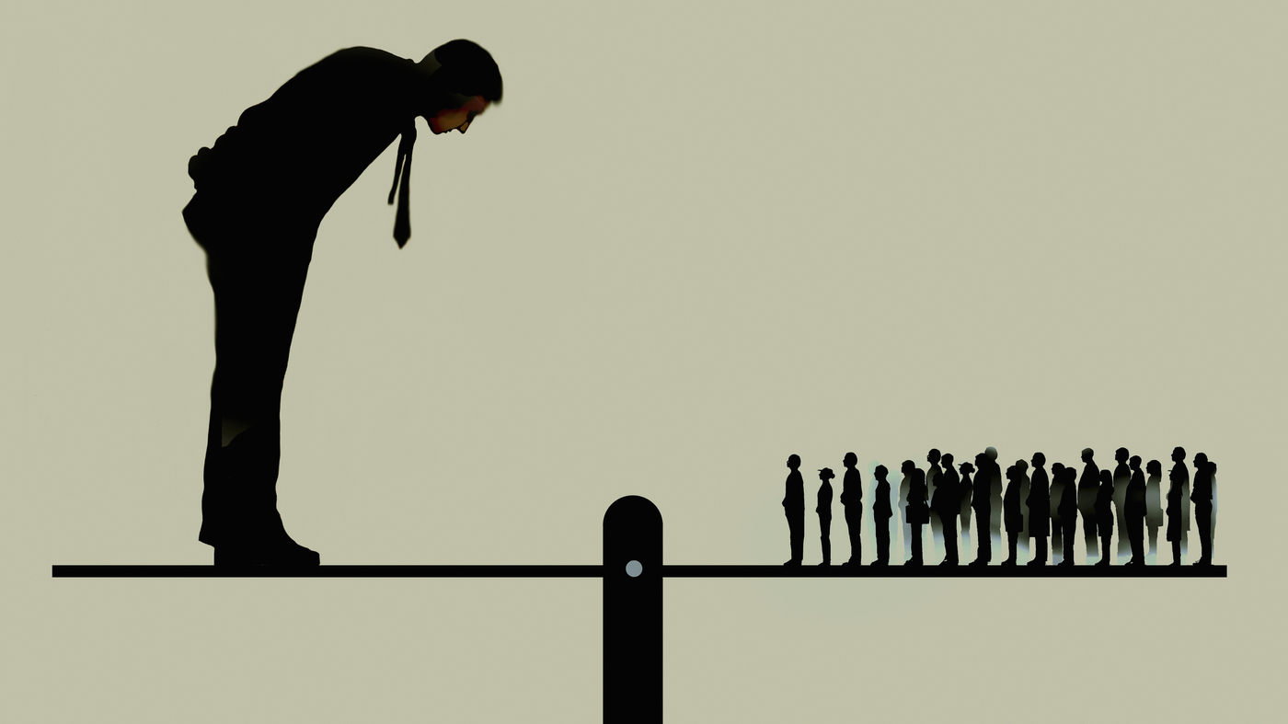
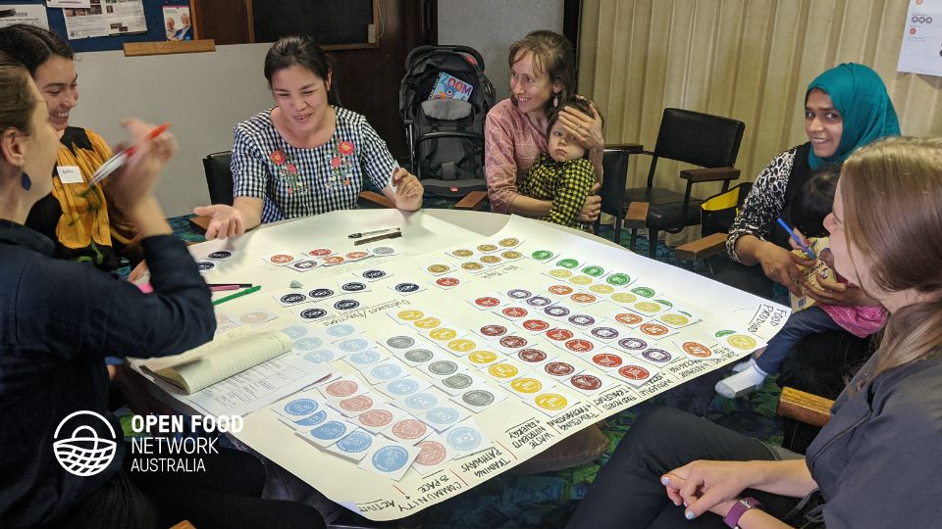
Co-Design for exploring & disrupting power
Power Over
Power With = Co-Design
Photo Example
How might we share power with community members to co-design system solutions that work for them?
Notes:
Please install the font, Poppins:
https://fonts.google.com/specimen/Poppins

Slide 5
Co-Design at Work: Ten of Ten for Kids
Photo Example
Notes:
Link: How a Non-profit is Using Human-Centered Design to Transform the Child Welfare System – YouTube Video is 3:41 min

Slide 6
Core Principles of Co-Design
Nothing About Me, Without Me
Curiosity & Beginner’s Mind
Humility & Empathy
Start small + learn fast
Make things tangible
Show work early + often
Photo Example

Slide 7
Visioning “How Might We…?”
Understand People’s Experiences
Collect Themes & Co-design a Prototype
Test Your Prototype or Intervention
Evaluate and get feedback from your co-designers
Adjust, Iterate and Test Again
Human Centered Design Process
Photo Example

Slide 8
A quick note about how to understand people’s experiences….
Questions for consideration:
Who are the people most impacted by the focus issue? How do you know this? What perspectives might be missing? Explicitly seek out the voices and perspectives that have not been included before.
Where do the people most impacted by the focus issue live? Understand the perspectives from people who live and work in these places.
Gather qualitative data to fill in the gaps of quantitative data. What and from who do you need to find out more to tell the whole story?
Go talk to people directly and spend time in these places.
Photo Example

Slide 9
At vero eos et accusamus et iusto odio dignissimos ducimus qui blanditiis praesentium voluptatum deleniti atque corrupti quos dolores et quas molestias excepturi sint occaecati cupiditate non provident, similique sunt in culpa qui officia deserunt mollitia animi, id est laborum et dolorum fuga.
Content Goes Here!
Content Goes Here!
Content Goes Here!
Content Goes Here!
Content Goes Here!
Notes:
2 Column Bulleted List
Please install the font, Poppins:
https://fonts.google.com/specimen/Poppins

Slide 15
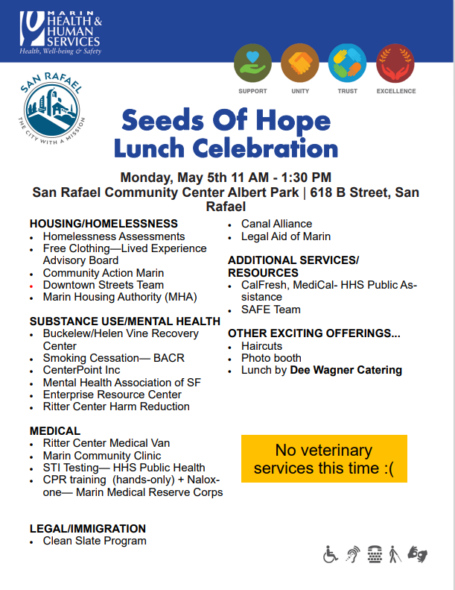
From 2022-Now!
Quarterly Seeds Of Hope Lunches/Fairs at encampments in Marin County
Approximately regular attendance of 300-400 people
One stop shop fair that is co-created/co-led with people living in the encampments

Slide 16
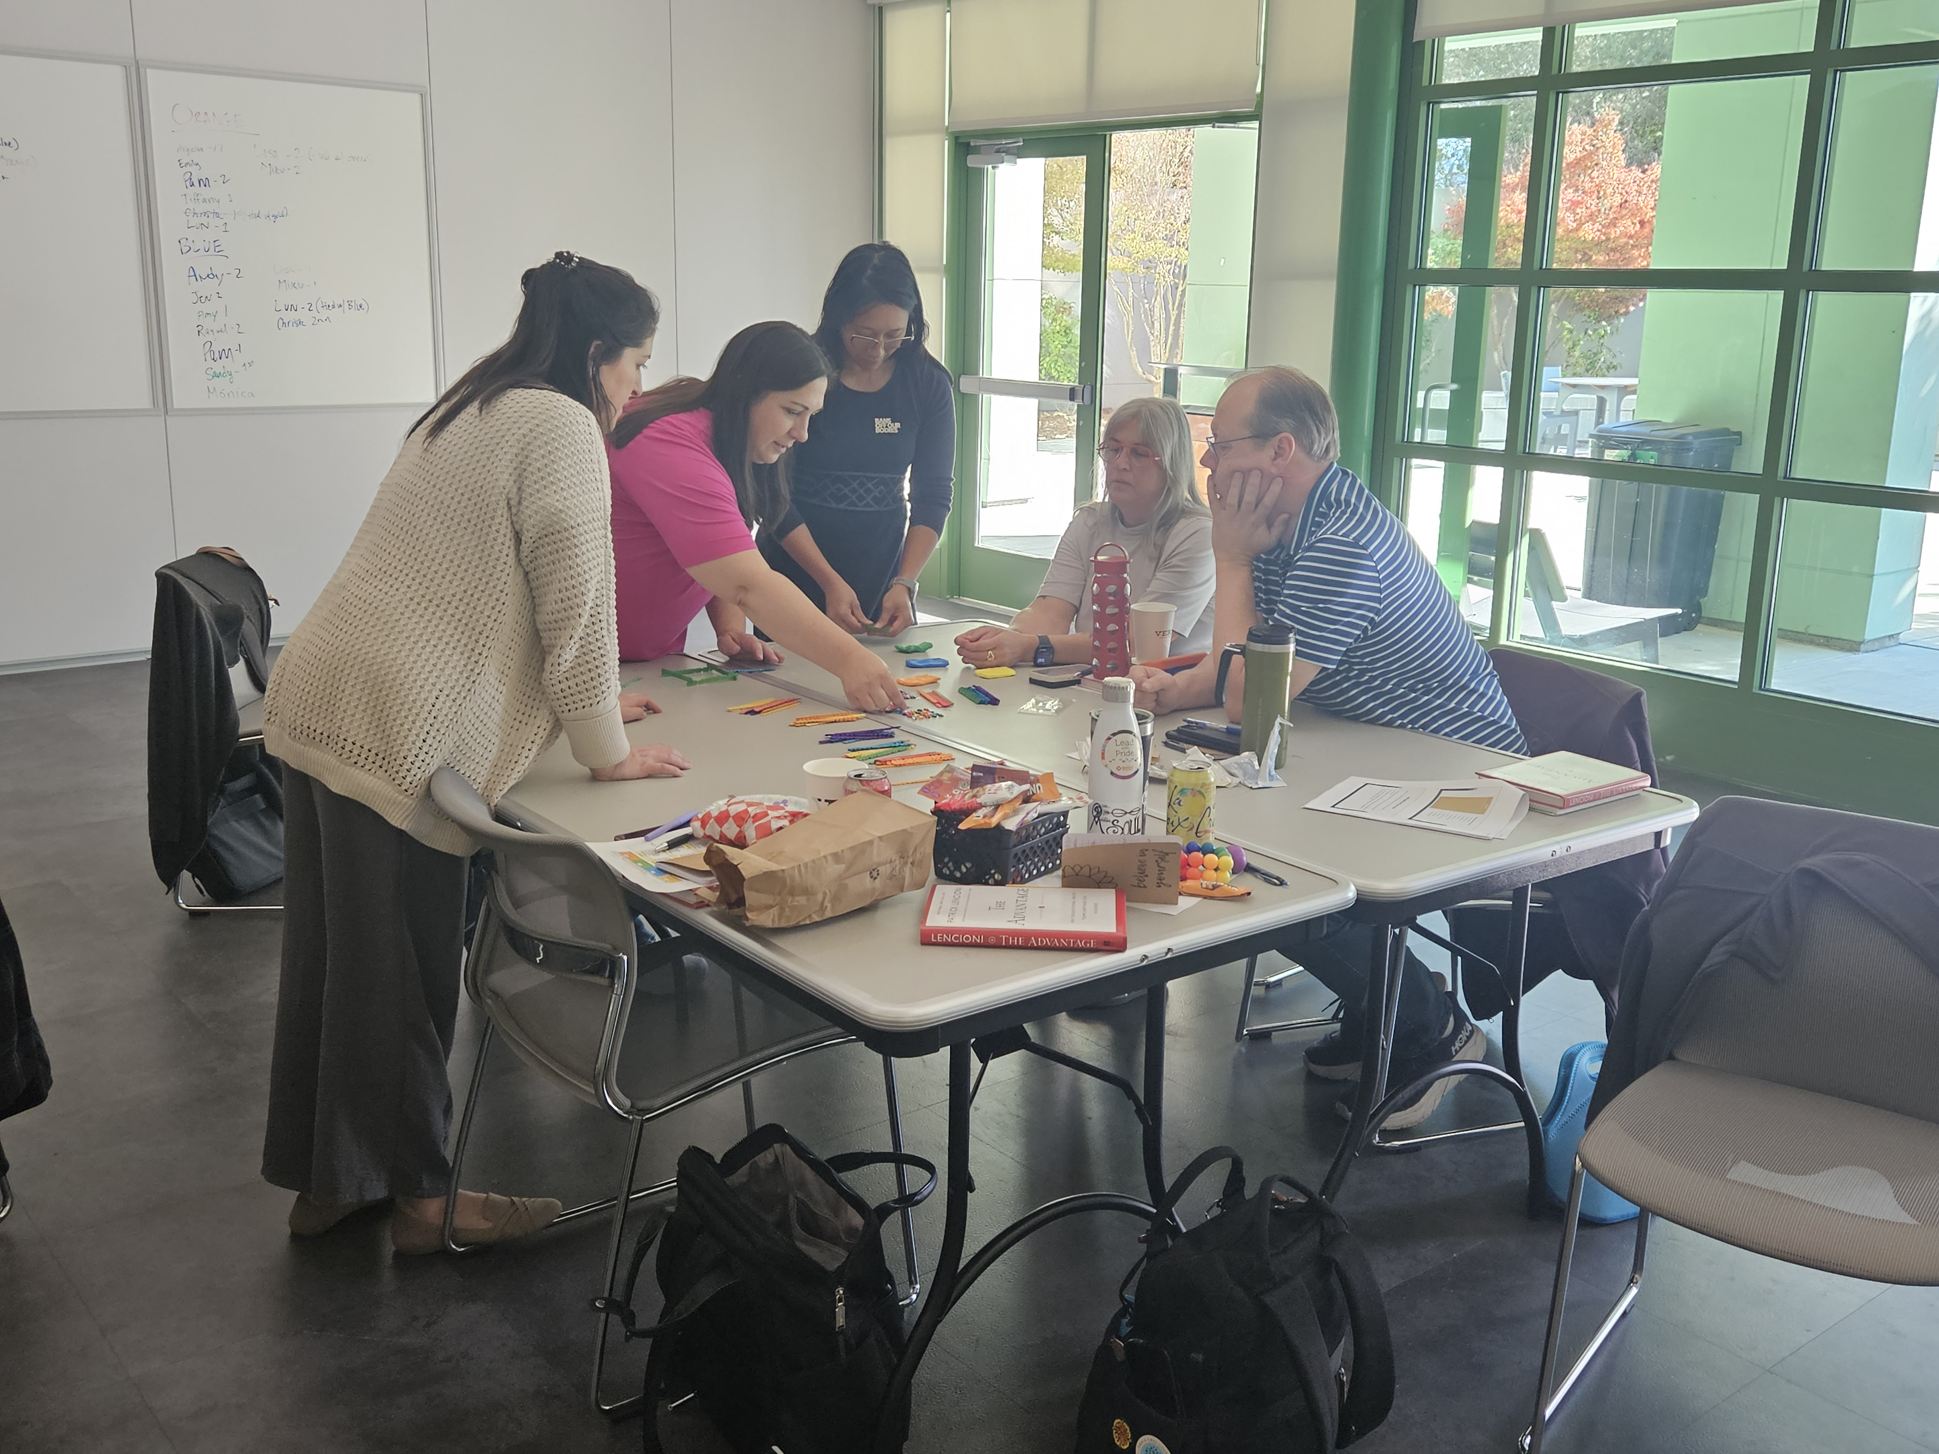
Breakout Activity
Share your name, role and organization.
Given the examples and concepts shared, discuss:
What opportunities exist in your work to share power and co-design with the people you serve?
What can you do to understand the perspectives of the people that are most impacted by your work?
Notes:
Note: Title of the Chart should be the title of the Slide.
Please install the font, Poppins:
https://fonts.google.com/specimen/Poppins

Slide 17
Closing Mentimeter Reflection Activity
Notes:
Put the mentimeter link in the chat: https://www.menti.com/albappjc4o6r
Lun will share screen to show people’s responses live.
Please install the font, Poppins:
https://fonts.google.com/specimen/Poppins

Slide 18
Human Centered Design Resources to Learn More
IDEO.org: The Architecture Behind Collaboration
The Center for Care Innnovations: Human Centered Design Resource Hub
Journey Mapping 101
How to Use a Persona
Interviewing Tool: Draw Your Experience
Collaboration Moves at the Speed of Trust: Reimagining Partnerships for Healing
Notes:
Please install the font, Poppins:
https://fonts.google.com/specimen/Poppins

Slide 19
Questions?
Thank You
Notes:
Please install the font, Poppins:
https://fonts.google.com/specimen/Poppins

