Slide 1
PDSA
Nada Algharib
IT Manager III, County of Santa Cruz – ISD
5/28/2025

Slide 2
Using the PDSA Cycle for Continuous Improvement
From Problem Identification to Targeted Change

Slide 3
Scientific method meets Action Learning meets Lean Method
Model for Improvement
What are we trying to accomplish?
How will we know that a change is an improvement?
Three simple questions
What change can we make that will result in improvement?
Team based
Real work setting
Focused on a test of change (the “do” is
for real!)
Act
Plan
Study
Do
The PDSA CYCLE
Adapted by IHI from The Model for Improvement,* developed by Associates in Process Improvement

Slide 4
PDSA
Plan: Identify a change to test
Do: Implement the change on a small scale
Study: Observe the results
Act: Decide what to do next

Slide 5
Why Use PDSA?
Low-risk, small-scale tests
Data-driven learning
Quick feedback
Builds team confidence
Supports adaptive, flexible improvement

Slide 6
PLAN – Developing the Test of Change
State the objective
Predict outcomes
Define the who, what, when, where
Plan for data collection

Slide 7
Do – Implementing the Change
Carry out the test
Document issues and observations
Begin collecting data

Slide 8
STUDY – Analyzing the Results
Compare results to predictions
Analyze what was learned
Look for unintended effects

Slide 9
ACT – Deciding Next Steps
Adopt: implement on a larger scale
Adapt: modify and retest
Abandon: discard and try a new approach

Slide 10

Setting the Stage for Change
Define
Define your target population
Clarify
Clarify the desired result
Conduct
Conduct a factor analysis
Identify
Identify key factors hindering success
Select
Select one Key factor to do small test of change

Slide 11
Expanding Affordable Internet Connectivity
All residents in Santa Cruz County are thriving, with increased access to health, employment, education, and overall connectivity to the world.
Focus Population: Households who receive subsidies in Live Oak
Focus Result: Eligible Live Oak area residents have access to affordable internet connectivity.

Slide 12
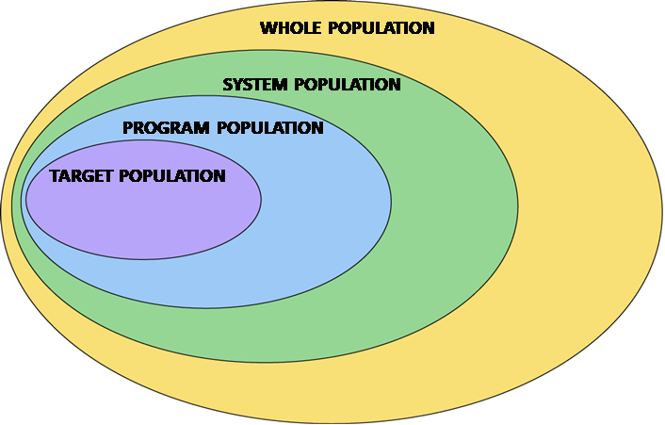
Focus Population
County of Santa Cruz Households
Focus Population
Low Income Households Eligible for Affordable Internet Offers
Households who receive subsidies in Live Oak.
Low Income Households

Slide 13
Live Oak area – Enrollment in Affordable Connectivity Program

Slide 14
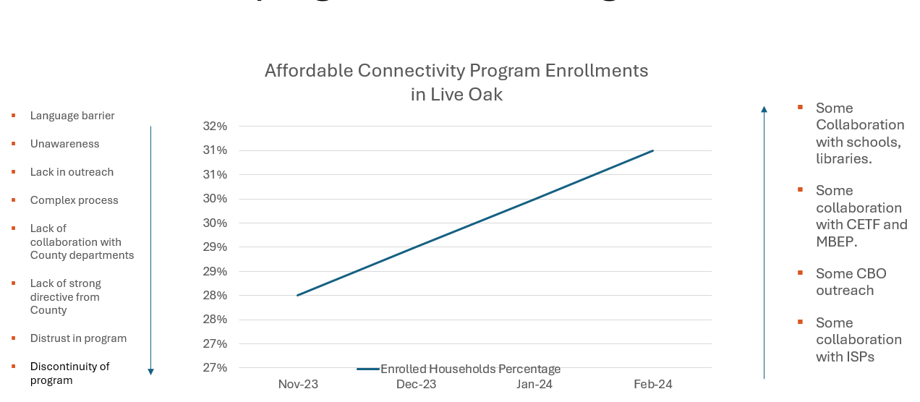
Factor Analysis – What’s helping/what’s hurting

Slide 15
Small Test of Change – Collaborating with County Departments (HSD/Benefits)
Eligibility for affordable offers include enrollment in Medi-Cal and CalFresh programs.
Small Test of Change:
  Leverage HSD’s existing processes for reaching and engaging with Medi-Cal and CalFresh clients.
  Collect data to see if enrollments in affordable offers increase.

Slide 16
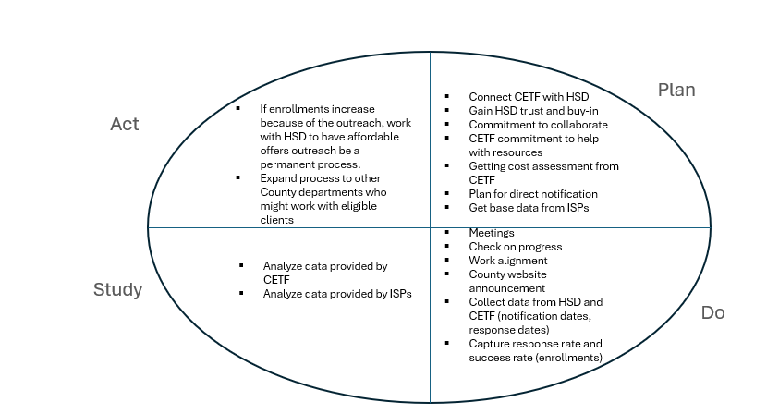
Small Test of Change – Collaborating with County Departments (HSD/Benefits)
Leveraging existing processes for outreach and awareness of affordable offers

Slide 17
PDSA - Key Takeaways
Start with a well-defined problem
Focus on one factor at a time
Test small, learn fast
Iterate towards improvement

Slide 18
Thank You!
Nada Algharib
IT Manager III, County of Santa Cruz - ISD
Breakout Session Questions:
Introduce yourself to the group
Discuss what project or program you could have used the PDSA tool before launching
What program or project will be good to use the tool

