Slide 1

Factor Analysis
The Importance of Factors
Factors shape how we create change – The actions we take are based on what we believe will lead to results.
Factors guide decision-making – They help us determine what to expand, adjust, or stop to improve outcomes.
Validating factors through multiple perspectives – To fully understand what’s driving change, we need input from different people, data sources, and lived experiences.

Slide 2
Steps of Factor Analysis
Complete an initial factor analysis using the steps below.
Define the Current State
  Is the trend improving, staying the same, or getting worse?
  What data or evidence supports this?
Identify Contributing Factors
  Gains Being Made: What’s driving progress or bright spots?
  Challenges to Address: What’s preventing improvement?
Dig Deeper: What’s Beneath the Surface? (Iceberg Analysis)
  Patterns – What repeated behaviors or trends are influencing this result?
  Structures – What policies, systems, or power dynamics are shaping the outcome?
  Mental Models – What beliefs or assumptions keep the current state in place?

Slide 3
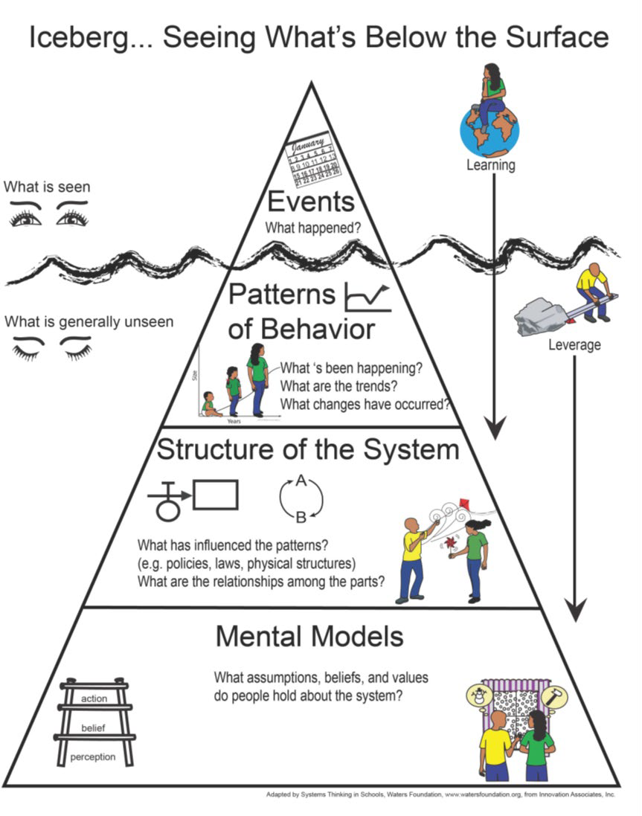
Keeping Systems Thinking in Mind
Look below the surface – Systems and history shape what we see.
Patterns drive change – Trends come from repeated actions.
Different views matter – Engaging diverse perspectives reveals factors.
Shift systems, not events – Long-term change requires structural shifts.
Adapted by Systems Thinking in Schools, Waters Foundation, www.watersfoundation.org

Slide 4
Getting to the Story Behind the Data Through Factor Analysis
Hindering
Helping
Current State
Future State

Slide 5
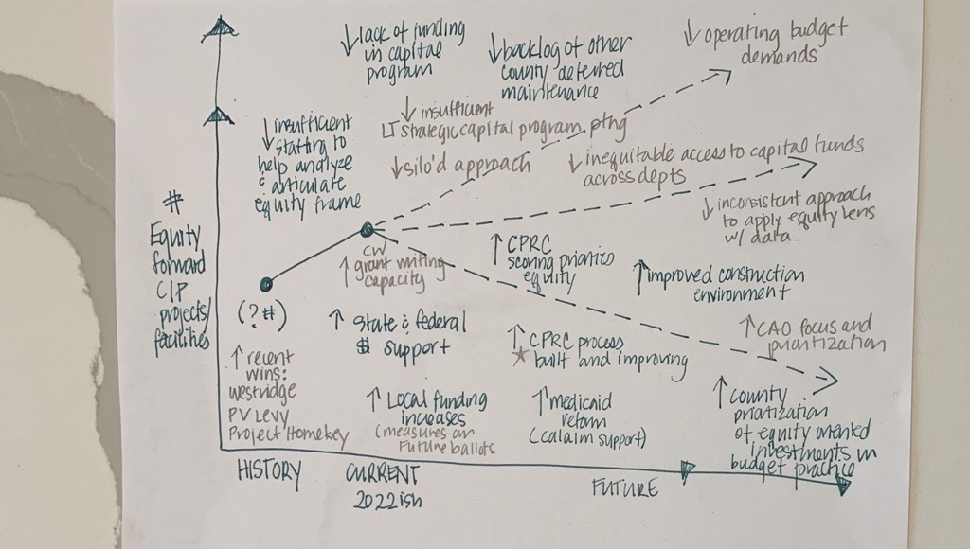

Slide 6
Factor Validation and Prioritization
Validate Factors: Are We Seeing the Whole Picture?
  Multiple Perspectives: Have we gathered insights from diverse voices, including those most impacted?
  Data & Lived Experience: Does the data align with what people are experiencing on the ground?
  Root Causes: Have we dug deep enough to uncover the true drivers of the issue?
Prioritize Action: Where Should We Focus?
  Impact: Which factors have the greatest influence on the outcome?
  Feasibility: What can realistically be changed with available resources?
  Leverage Points: Where can small shifts create big results?
Prioritizing validated factors helps us focus on strategies that drive meaningful, lasting change.

Slide 7
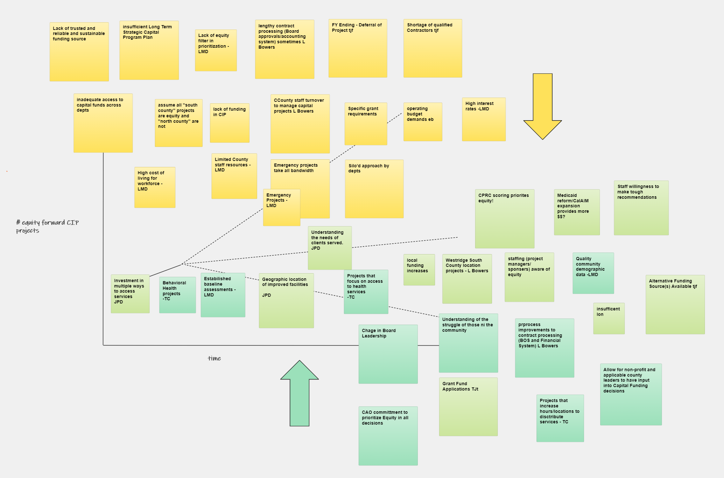

Slide 8
Factor Validation leading to strongest strategy to increase Equity Forward CIP
KEY FACTORS
Staff Capacity including focus, training, skill
Community engagement for input and partnering
Lack of Dedicated funding
Competing Priorities – operating budget and other initiatives
Emergency repairs
Leadership priority and focus
Grant funding
Several county staff groups discussed helping and hindering factors
All indicated the need to commit resources to develop and train
Discussion confirmed strongest strategy is to improve existing decision-making processes and sharpen equity focus and use of data

Slide 9
Strong Strategies and small tests of change
Standardize Capital Budgeting Process and bring clarity to funding criteria
  Define what equity means in the capital budgeting process
  Improve and iterate Project Scoring instruments
  Build staff capacity to understand and address how capital investments do or do not proactively address the wellness, safety, and opportunities experienced by BIPOC and low income people
  Provide technical assistance and training every step of the way
  Collect data, analysis it and PDSA again!
  Involve staff with different views of the process

