Slide 1

Cross-Training
During VUCA Times
Building Agile, Resilient Organizations Through Multi-Skilled Workforces
Sara Mezher, MPH
Administrative Services Manager
Fiscal Unit-Administrative Services
County of Santa Cruz Human Services Department

Slide 2





01
AGENDA
What Is Cross-Training?
Today's Discussion
02
Importance During VUCA Times
03
Research & Evidence
04
Models & Approaches
05
Recommendations

Slide 3
“
WHAT IS CROSS-TRAINING?
Cross-training is a workforce development strategy in which employees acquire the skills and knowledge necessary to perform tasks beyond their primary job responsibilities, thereby increasing organizational flexibility, workforce adaptability, and continuity of operations (Noe, 2020).
FLEXIBILITY
RESILIENCE
AGILITY

Slide 4
WHAT THE RESEARCH SAYS
94%
(LinkedIn Learning, 2018)
29.5% (Love & Roper, 2009)
of employees would stay longer at a company that invests in their learning and development
higher innovation success rate in organizations that effectively use cross-functional teams
36.6%
(SHRM Workforce Flexibility Study, 2021)
70%
(Center for Creative Leadership (CCL)
of productivity loss is associated with an unplanned absence.
of learning occurs through on-the-job cross-functional experiences (70-20-10 model)
Notes:
70% experiential learning (learning by doing, cross-functional projects, cross-training)
20% social learning (learning from others through coaching, mentoring..)
10% formal learning (courses, workshops..)

Slide 5




THE VUCA ENVIRONMENT
V
Volatility
U
Uncertainty
C
Complexity
A
Ambiguity
Rapid, unpredictable change in markets, workforce needs, and organizational priorities.
Lack of predictability in outcomes; difficulty forecasting staffing and skill requirements.
Multiple interconnected systems and dependencies that make decisions difficult.
Unclear situations where cause-and-effect relationships are hard to define.

Slide 6





WHY CROSS-TRAINING MATTERS IN VUCA ENVIRONMENTS
Operational Continuity
Organizational Resilience
Adaptive Capacity
Ensures critical functions continue during absences, turnover, or emergencies — eliminating single points of failure.
Builds the capacity to absorb disruption and recover quickly by distributing knowledge across the workforce.
Employees with multi-functional skills can pivot roles during crises, mergers, or rapid market shifts.
Knowledge Retention
Workforce Agility
Employee Engagement
Reduces institutional knowledge loss from retirements or departures by distributing expertise broadly.
Enables rapid redeployment of talent to high-priority areas without the lag of external hiring.
Cross-trained employees report greater job satisfaction, stronger sense of purpose, and reduced burnout.

Slide 7




CROSS-TRAINING MODELS & APPROACHES
Job Rotation
Job Shadowing
Stretch Assignments
Employees rotate between departments on a scheduled basis, gaining broad operational exposure over 3–6 month cycles.
Short-term observation of colleagues in other roles. Low-disruption entry point for cross-training programs.
Employees take on projects or responsibilities outside their normal role to build new competencies intentionally.
Peer Coaching Pairs
Formal Classroom
Project-Based Learning
Cross-functional pairs exchange knowledge and skills. Builds relationships and transfers tacit organizational knowledge.
Structured internal training sessions led by SMEs covering systems, processes, and competencies of other functions.
Cross-departmental project teams expose employees to diverse workflows, decision-making styles, and tools.

Slide 8



RECENT CROSS TRAINING:
FISCAL –ACCOUNTS PAYABLE (AP)
Some AP Services
Peer Coaching Pairs
Learning Lessons
Accelerate knowledge transfer
Break down organizational silos
Increase adaptability and workforce flexibility
Improve innovation and problem-solving
Strengthen employee engagement and development
Support succession planning and organizational resilience
.
Processing Invoices
processing Journals
Intercept reconciliation
Trust: Creating a safe, confidential environment.
Listening: asking thoughtful questions rather than giving solutions.
Different Perspectives: diverse experience and perspectives lead to innovation.
Honest feedback: delivering feedback accelerates growth.

Slide 9

GROUP ACTIVITY
Cross-Training Model: Select one of the cross-training approaches/models you’ve implemented recently or have been part of
.
Successful results: list the successful results that came out of this approach. Results may include those on personal level and/or those related to work quality and outputs
Learning Lessons: list any challenges or areas of improvement that were identified and list the lessons learnt.

Slide 10




RECOMMENDATIONS
Start with Skills Mapping
Balance Depth vs. Breadth
Incentivize Participation
Use a skills matrix to identify gaps, overlaps, and critical knowledge holders before designing cross-training paths.
Pair breadth rotations with deep-dive modules to ensure genuine competency transfer.
Tie cross-training completion to performance reviews, career advancement, and recognition programs.
Build a Skills Redundancy Index
Embed in Onboarding
Measure ROI Continuously
Maintain a live dashboard showing coverage ratios for critical roles — targeting at least 2 backups per key function.
Introduce cross-functional awareness from day one so that agility becomes a core cultural expectation.
Track absenteeism cost, time-to-fill gaps, and engagement scores quarterly. Report outcomes to leadership.

Slide 11
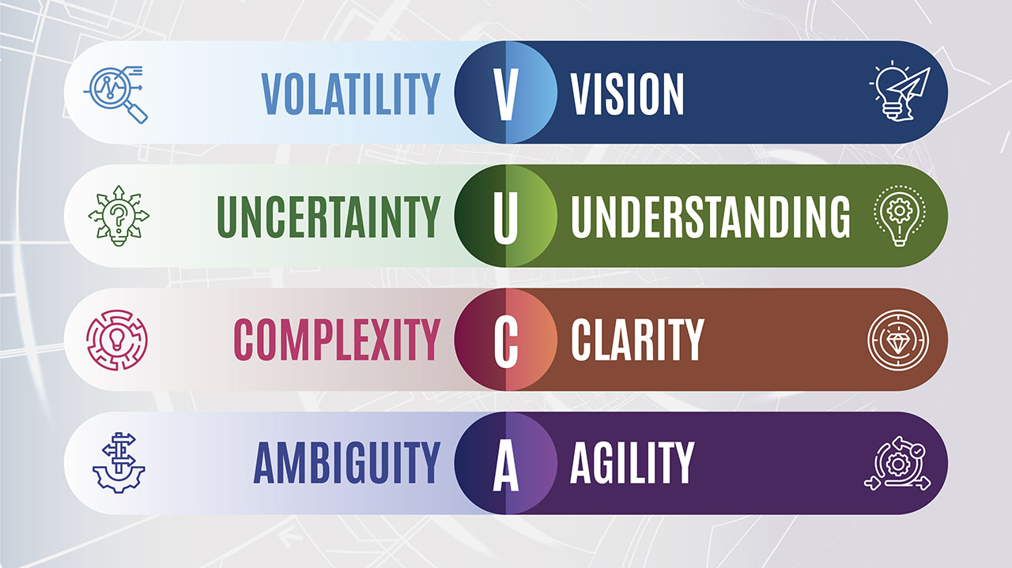
https://www.disruptiveleadership.institute/vucad-framework/
Notes:
The VUCA Prime model was developed by Robert Johansen. Johansen flips the VUCA model and focuses on the characteristics and skills business leaders must develop to counter the effects of a VUCA environment. Johansen proposes that the best VUCA-driven disruptive leaders have a vision, understanding, clarity, and agility.

Slide 12

Agile Teams Begin with
Cross-Trained People
In a VUCA world, the organizations that survive are the ones who invest in flexibility before they need it.
Questions & Discussion

Slide 13
REFERENCES
LinkedIn Learning. (2018). 2018 workplace learning report. LinkedIn Learning.
Deloitte Insights. (2022). Global Human Capital Trends: The Social Enterprise at Work. Deloitte Touche Tohmatsu Limited.
Society for Human Resource Management, & Kronos Incorporated. (2014). Total financial impact of employee absences in the U.S.: Executive summary. Society for Human Resource Management. PDF Report
Center for Creative Leadership (CCL). (2020). The 70-20-10 Rule for Leadership Development. CCL Press.
Love, J. H., & Roper, S. (2009). Organizing innovation: Complementarities between cross-functional teams. Technovation, 29(3), 192–203. https://doi.org/10.1016/j.technovation.2008.07.008
Bennett, N., & Lemoine, G. J. (2014). What VUCA Really Means for You. Harvard Business Review, 92(1/2), 27.
Cascio, W. F. (2019). Managing Human Resources: Productivity, Quality of Work Life, Profits (11th ed.). McGraw-Hill.
Noe, R. A. (2020). Employee Training and Development (8th ed.). McGraw-Hill Education.
ATD. (2022). State of the Industry Report: Workplace Learning & Performance. Association for Talent Development.

